Slide 1

Should there be a mandatory code of conduct for all data scientists?

Slide 2
What is a code of ethics/conduct?
“A code of ethics or ethical code refers to a set of guidelines, standards, and principles that a company adopts and that must be adhered to by its workers.”
“Codes of ethics are often determined by the professional body, company management or the association.”
https://thebusinessprofessor.com/en_US/ethics-social-responsibility/code-of-ethics-definition

Slide 3
Why do certain professions have them?
Enshrine values into practice
Ensure a minimum professional standard

Slide 4
Why does data science need an ethical code?
Growing influence of data over people’s lives
Examples of misuse of data/ethical oversights

Slide 5
What would it look like?
Universal
Specialised

Slide 6
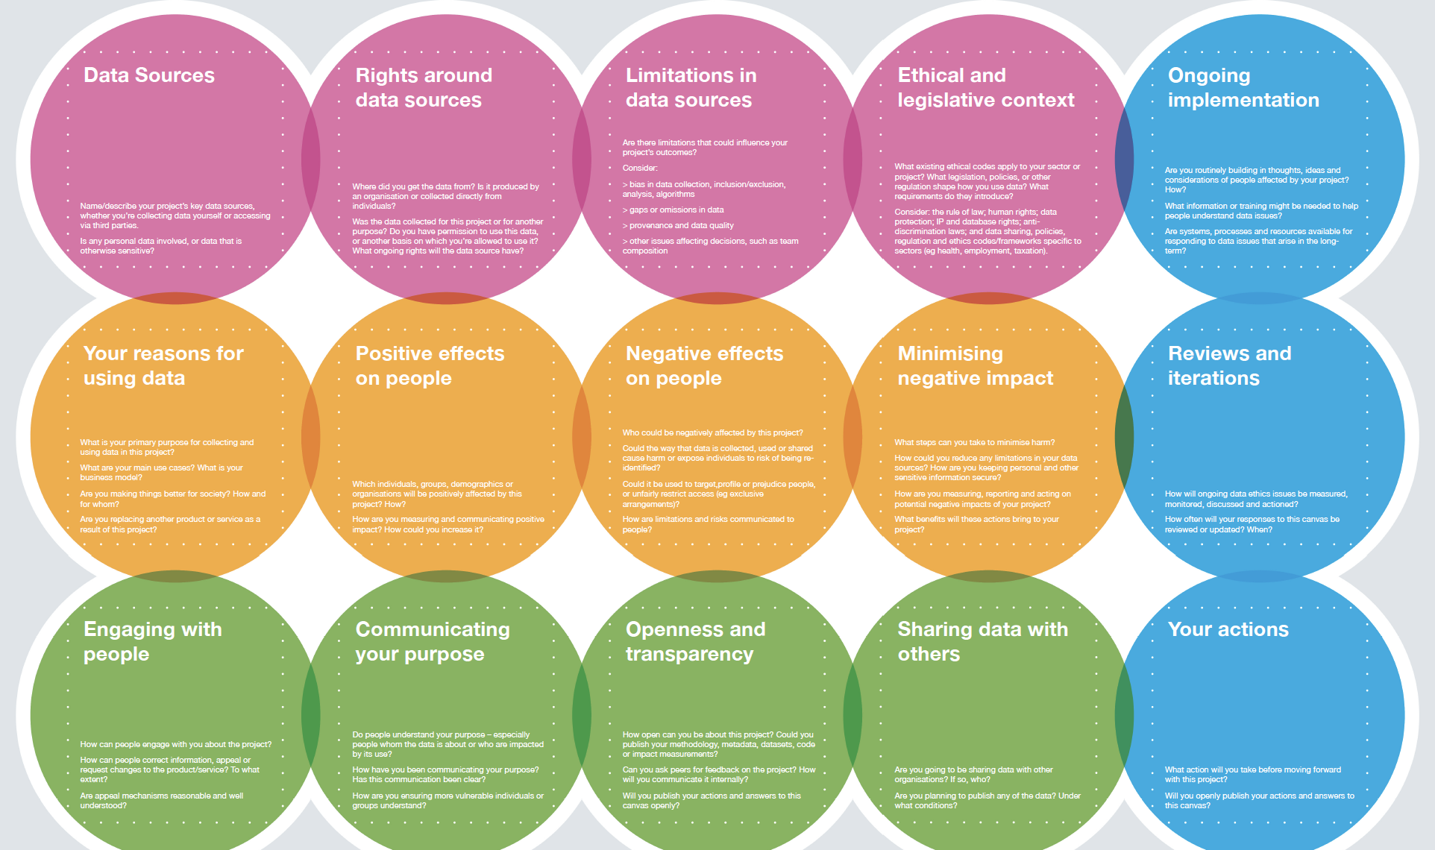
http://theodi.org/wp-content/uploads/2021/07/Data-Ethics-Canvas-English-Colour.pdf

Slide 7
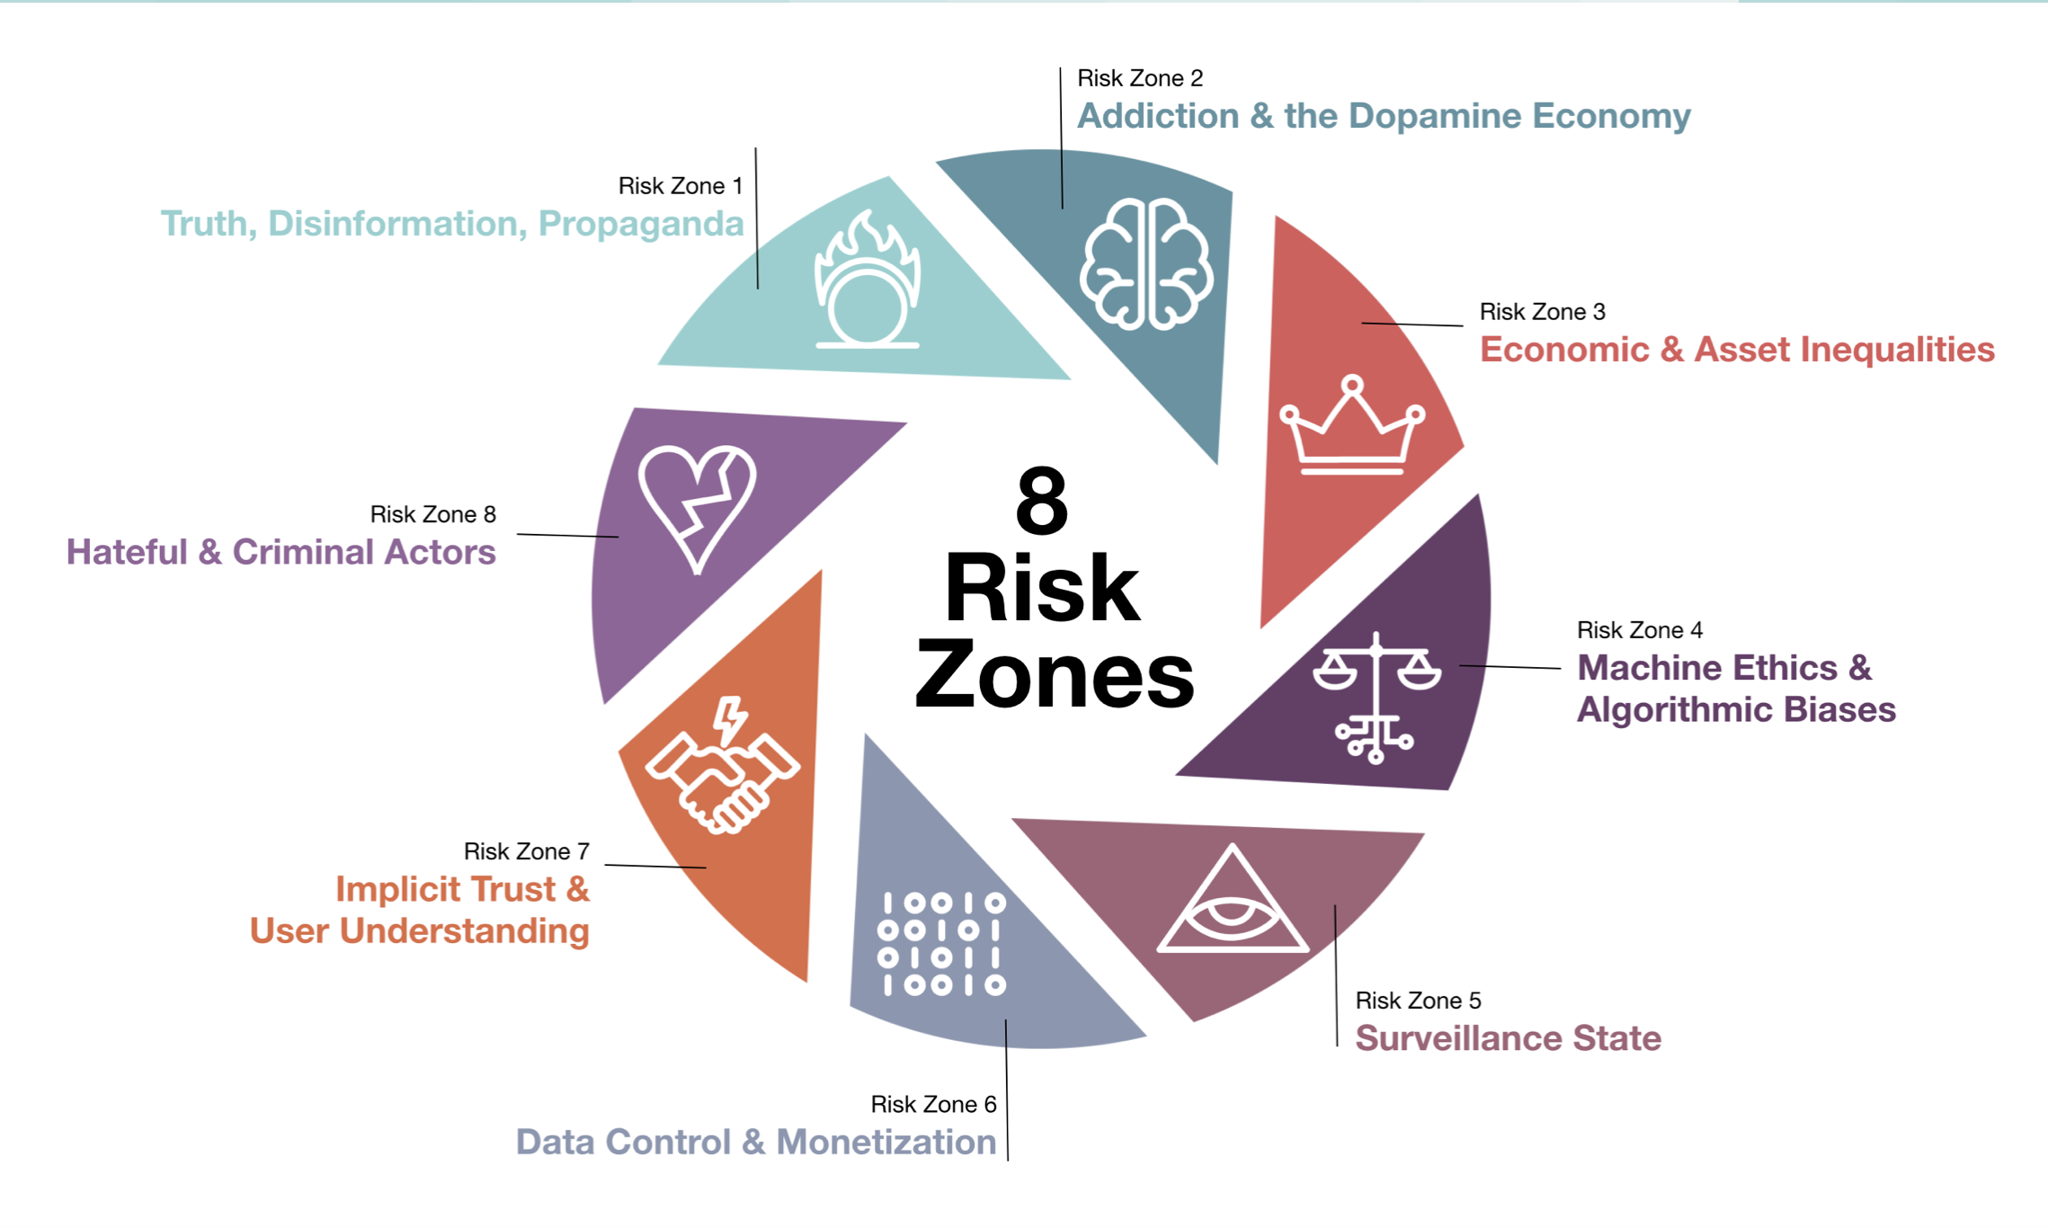
https://ethicalos.org

Slide 8
Who decides?
Businesses
The Law
Independent bodies
Individuals

Slide 9
Data science without an explicit code/regulation?
“The practice of fabricating or exaggerating a company’s interest in equitable AI systems that work for everyone.”
Ethics Washing
https://venturebeat.com/2019/07/17/how-ai-companies-can-avoid-ethics-washing/

Slide 10
Sources
https://thebusinessprofessor.com/en_US/ethics-social-responsibility/code-of-ethics-definition
http://theodi.org/wp-content/uploads/2021/07/Data-Ethics-Canvas-English-Colour.pdf
https://ethicalos.org
https://dataethics.eu/ethics-washing-is-when-ethics-is-a-substitute-for-regulation/
https://venturebeat.com/2019/07/17/how-ai-companies-can-avoid-ethics-washing/

